Slide 1
Group 2
Heather , tom , Lewis and Courtney

Slide 2
Brief
Achieving psychological flow for players.
Working with the theme of ‘ Light VS Darkness’.
Appealing to Easy Fun , Hard Fun and Serious fun..

Slide 3
ACHIEVING FLOW
Concrete goals with manageable rules
Goals that fit player capabilities.
Clear and timely feedback.
Eliminate distractions
Collectables

Slide 4
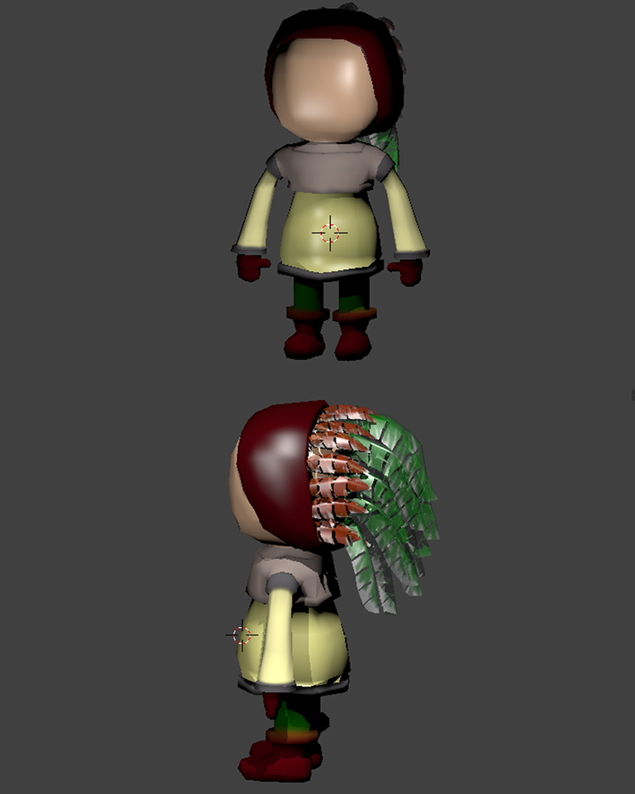
Narrative
The narrative follows the theme of dark vs light, with the player experiencing two worlds.
HB

Slide 5
How to introduce the narrative to the audience.
comic book style loading screens.
-environmental storytelling through props, writing on the wall.
-audio in the form of dialogue between characters that will either be a memory of a conversation or like a real time narrator.
-fire god animations change to indicate deteriorating health.
-menu and options screen changes image and text based on where you are in the game .
HB

Slide 6
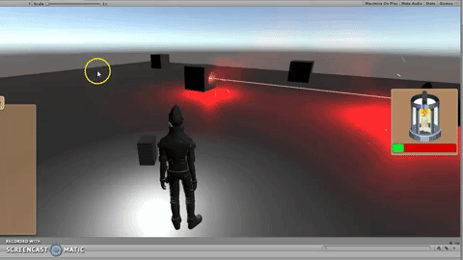
Past gameplay
TW

Slide 7
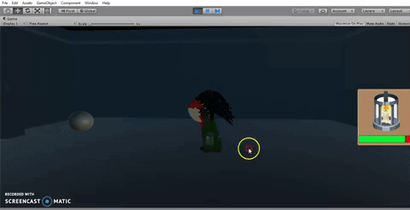
Present Game Play
CP

Slide 8
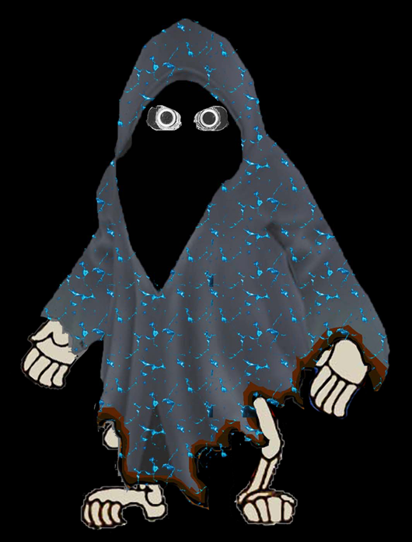
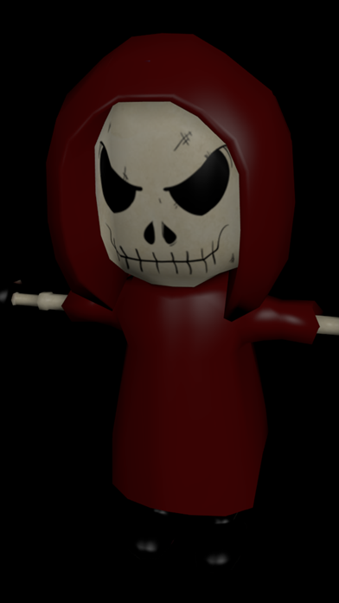
Enemies
Standard Enemies
Patrollers

Slide 9
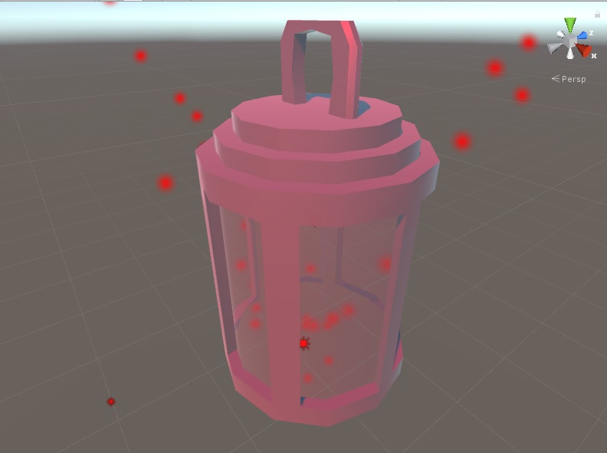
New mechanics
Added Elements
Red – Fire -Fire Grenades to distract spirits - Can burn obstacles -Melt Ice
Blue – Ice -Freezing Water to create paths - Freezing Patrollers
Green – Earth -Using Stone grenades to break walls
TW

Slide 10
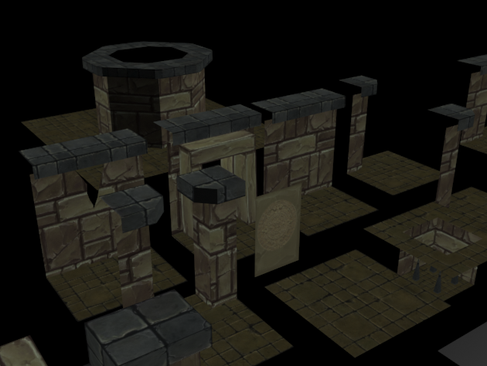
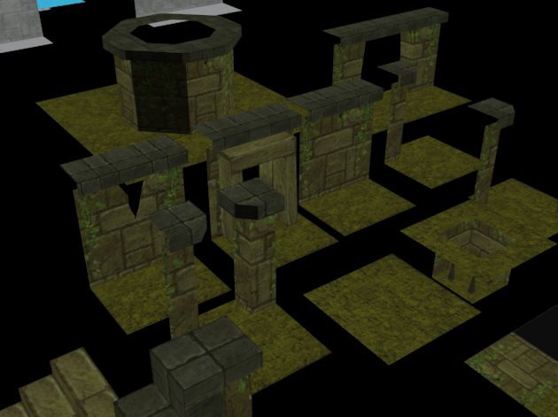
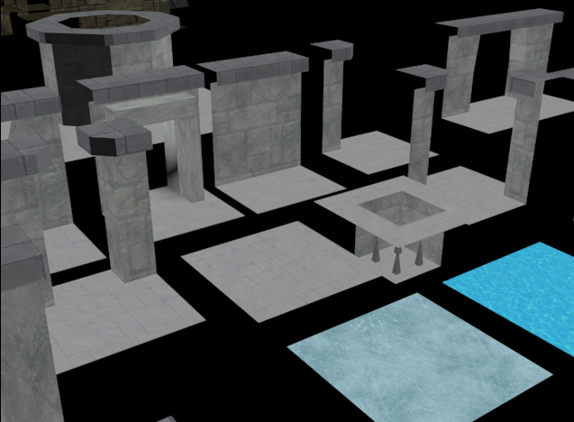
New Level design
Created new level design’s based around the elements.
TW

Slide 11
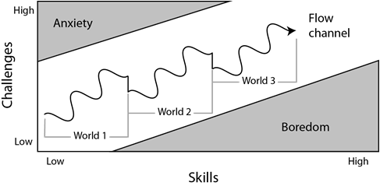
Player experience
The game will be a puzzle game primarily, so curiosity and challenge are essential. The puzzles will get gradually more complex, but with little or no punishment or lost progress to keep frustration low.
Challenge VS Skill
HB

Slide 12
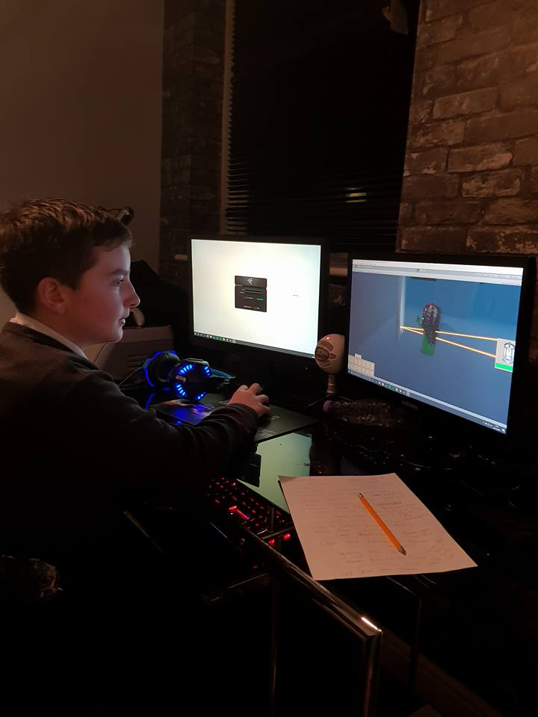
Psychographic
Name : Shankly
Age: 13
Interests: Playing video games and watching films.
Life Style :
A lot of free time as he plays Games after school for 6 hours.
Loves games where he can explore, he is patient and enjoys taking his time.
Repetition and multitasking for Zen focus for optimum difficulty/boredom curve.
Plays games and watch films which are humorous.
CP

Slide 13
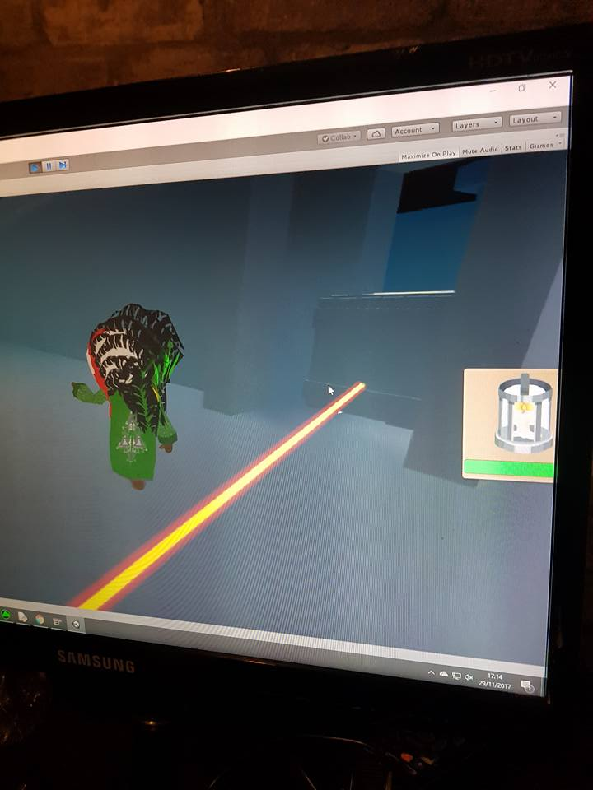
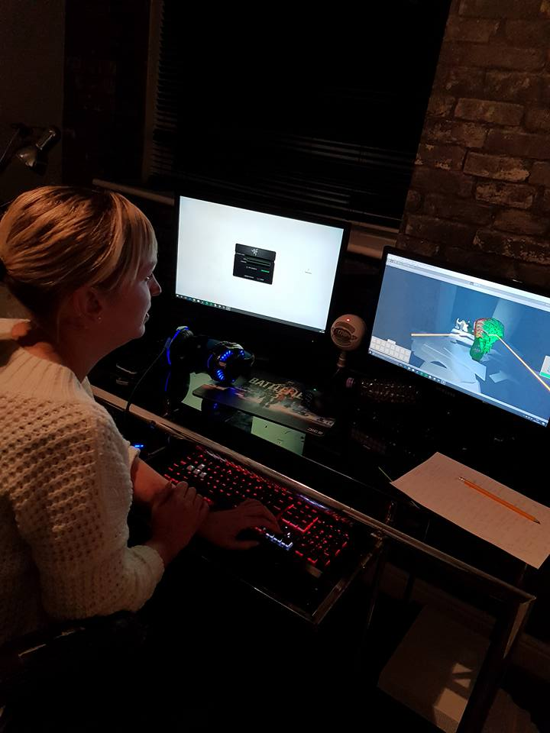
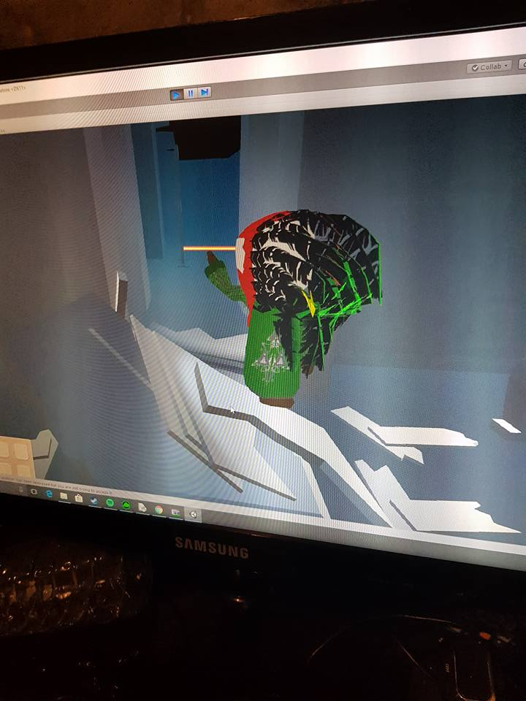
Playtesting feedback
Camera needed fixing
Character was blocking the view of objectives
Could grab two mirrors at once
Some Boxes didn’t break
There was no collider on destructible objects
Could walk past the boxes
Could reflect light from the back of the mirror
The death mechanic didn’t work
CP

Slide 14
Bug fixing / Progression
Narrative Based Prop design – Used as objective pick-ups / solving puzzles.
Narrative Fully Outlined
Written text / cut scenes
Final Level Design – Particle Effects
Lighting
Adding UI
TW

Slide 15
Any questions?

